Slide 1
Selenium Java

Slide 2
What is?
Selenium is a free (open source) automated testing suite for web applications across different browsers and platforms. It is quite similar to HP Quick Test Pro (QTP now UFT) only that Selenium focuses on automating web-based applications. Testing done using Selenium tool is usually referred as Selenium Testing.
Selenium is not just a single tool but a suite of software's, each catering to different testing needs of an organization. It has four components.
Selenium Integrated Development Environment (IDE)
Selenium Remote Control (RC)
WebDriver
Selenium Grid

Slide 3
WebDriver
WebDriver is a web automation framework that allows you to execute your tests against different browsers, not just Firefox, Chrome (unlike Selenium IDE).
WebDriver also enables you to use a programming language in creating your test scripts (not possible in Selenium IDE).
You can now use conditional operations like if-then-else or switch-case. You can also perform looping like do-while.

Slide 4
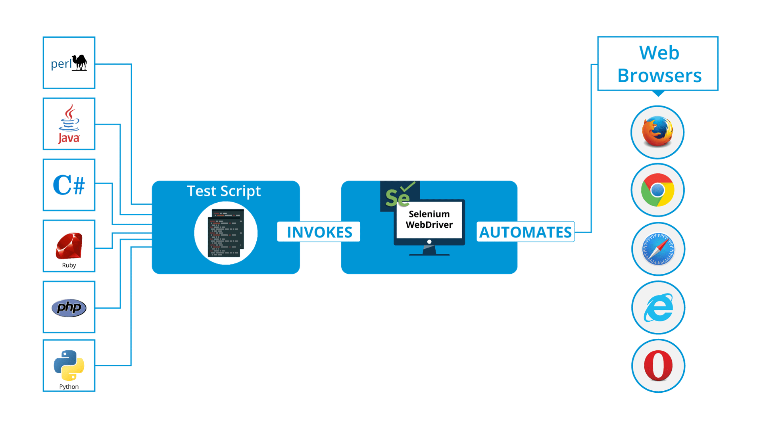

Slide 5
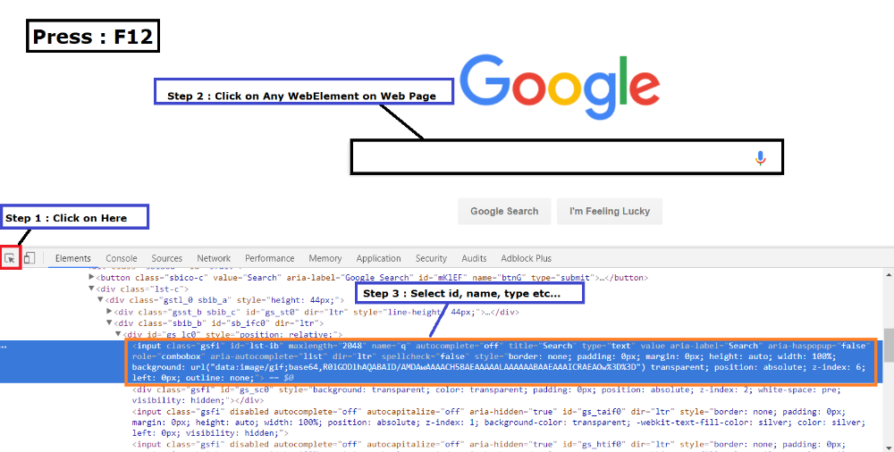
WebElement and Locators
Anything that is present on the web page is a WebElement such as text box, button, etc. WebElement represents an HTML element.
Locators are defined as an address that identifies a WebElement uniquely within a web page.
Id locator
Name locator
linkText & Partial linkText
CSS Selector
XPath
Locators in Selenium- WebElements in Selenium- Edureka

Slide 6
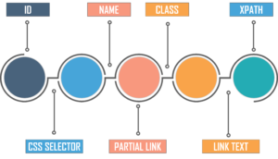
ID locator: The most popular way to identify web element is to use ID. ID’s are considered as the safest and fastest locator option and should always be the first priority among multiple locators.
Name locator: This is also an effective way to locate an element which has a name attribute. With this strategy, the first element with the value of the name attribute will be returned. If no element has a matching name attribute, then a NoSuchElementException will be raised.
linkText & ParialLinkText: You can identify the hyperlinks on a web page using this linkText. It can be determined with the help of an anchor tag (<a>). To create the hyperlinks on a web page, you can use the anchor tags followed by the link text. In some cases, you may need to find links by a portion of the text in a linkText element. In such situations, you can use Partial Link Text to locate elements.
CSS Selectors: CSS is mainly used to provide style rules for the web pages and you can use it for identifying one or more elements in the web page. The CSS selector is always the best possible way to locate complex elements in page. We’ll talk more about CSS selectors in the next topic.
XPath: XPath is a language to query XML documents. XPath is an important strategy to locate elements in selenium. It also consists of a path expression along with some conditions. Here, you can easily write an XPath script/query to locate any element in the webpage.

Slide 7
https://seleniumhq.github.io/docs/site/en/getting_started_with_webdriver/
https://www.browserstack.com/guide/selenium-with-java-for-automated-test
https://www.guru99.com/selenium-tutorial.html
https://testautomationu.applitools.com/learningpaths.html?id=web-ui-java-path

